Slide 1
Access as a Civil Right
Notes:
Welcome, everyone. [Introductions as appropriate.] Our focus today is on access and the civil rights movement in the U.S. During this session, we’ll look back on a few key moments in the civil rights movement and consider where we are today—asking ourselves if access is indeed perceived as a civil right.

Slide 2
Fay Quote
“I think in the 50s, people didn’t even consider themselves a minority group. They didn’t think of ‘disability rights’ as two words that went together.”
Fred Fay
Disability Activist
Notes:
The American Heritage Book of English Usage, published in 1996 states: “One of the most basic ways of showing respect for others is to refer to them by the names with which they have chosen to identify themselves and to avoid using names that they consider offensive.”
Rather than setting out certain rules about what is okay and is not okay to say, I’d like for us to have a dialogue about language and disability.

Slide 3
504 Quote
“No otherwise qualified individual with a disability in the United States…shall, solely by reason of her or his disability, be excluded from the participation in, be denied the benefits of, or be subjected to discrimination under any program or activity receiving federal financial assistance…”
Section 504 of the Rehabilitation Act of 1973
Notes:
“No otherwise qualified individual with a disability in the United States…shall, solely by reason of her or his disability, be excluded from the participation in, be denied the benefits of, or be subjected to discrimination under any program or activity receiving federal financial assistance…”

Slide 4
504 Sit-In
Notes:
But when the signing of the 504 regulations that would enforce this law was delayed, disability activists organized one of the most powerful protests our nation has ever seen—the 504 Sit-In. In response to the protests, a congressional hearing was convened. We’ll watch a few of the testimonies of that hearing.
You’ll hear from disability activists, Ed Roberts, Phil Newmark and Judy Heumann.
Play The Power of 504 Video from 2:15 to 4:55.

Slide 5
Heumann Quote
“We will no longer allow the government to oppress disabled individuals. We want the law enforced. We want no more segregation. We will accept no more discussion of segregation.”
Judy Heumann
Disability Rights Activist
Notes:
I’d like to repeat what Judy Heumann said in the video, “I can tell you that every time you raise issues of ‘separate but equal’ the outrage of disabled individuals across the country is going to continue. It’s going to be ignited.” And then… “We will no longer allow the government to oppress disabled individuals. We want the law enforced. We want no more segregation. We will accept no more discussion of segregation.”
Building on the civil rights movement of African Americans where Brown v. Board of Education struck down the practice of segregated, so-called “separate but equal” education, the fight for equal access challenged practices of segregation faced by disabled people.

Slide 6
Access to Transportation
Notes:
The slogan “Access is a Civil Right” emerged during protests in the ’80s where disabled activists blocked city transit because of its inaccessibility. The organizing and relationships established during the ’70s and ’80s laid the groundwork the passage of the Americans with Disabilities Act.
This video highlights the activities and emotions on day of the signing of the ADA.
Play The Americans with Disabilities Act, Signing Ceremony, July 26, 1990

Slide 7
Bush Quote
“Let the shameful wall of exclusion finally come tumbling down.”
George H. W. Bush 41st President of the United States
Notes:
The powerful statement of George H. W. Bush, “Let the shameful wall of exclusion finally come tumbling down,” continues to hold power today. We would hope that we could say that that wall came tumbling down on that very day. But did it?
Pose questions for discussion. Choose questions appropriate for your audience.
Do you see examples today of segregation of people with disabilities?
Do you see attempts at achieving access through a separate but equal approach?
Let’s look at some examples of ways access is provided.

Slide 8
CAPTIONING
79% of the representatives stated that they think they are only partially meeting the requirements to provide captioning.
Research by Kate Linder
Notes:
In a research project conducted by Kate Linder, 47 postsecondary institutions were surveyed about their captioning practices. 79% of the representatives from those institutions stated that they think they are only partially meeting the requirements to provide captioning.

Slide 9
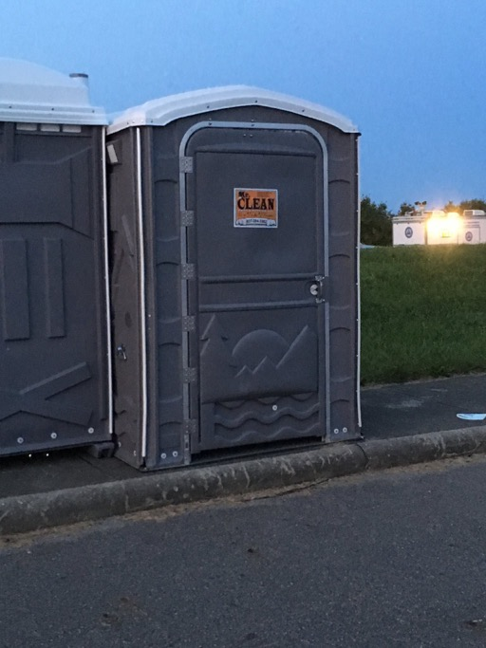
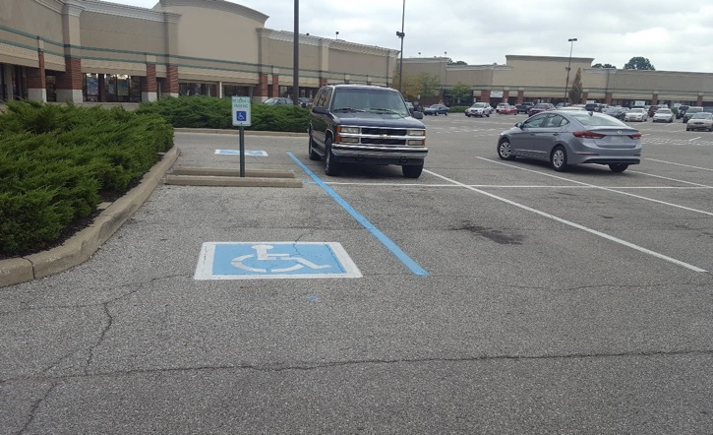
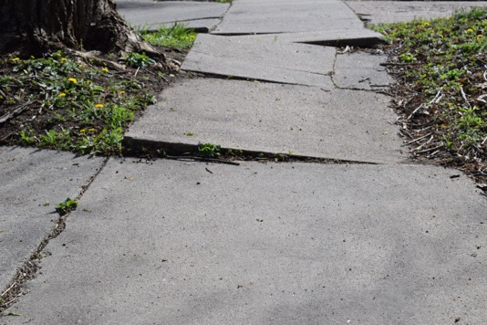
Photo examples
Notes:
This slide shows a series of photos. A sign that shows access to the side of the building. A supposedly accessible portable toilet that’s place on a curb. A broken sidewalk. And a supposedly accessible parking space with no accessible route.

Slide 10
Website accessibility
A study of approximately 500 federal websites revealed that only 60 percent were accessible to people who are blind.
Source: Benchmarking U.S. Government Websites
Notes:
A study of approximately 500 federal websites revealed that only 60 percent were accessible to people who are blind. Source: https://itif.org/publications/2017/11/27/benchmarking-us-government-websites
These are just a few examples of how we fall short of providing full and equal access.
Pose questions for discussion. Choose questions appropriate for your audience.
Can you think of other examples?
If we embrace access as a civil right, what kinds of things would we stop doing?
What would we do more of?

Slide 11
Disability Rights Movement Images
Notes:
Describe images: A bumper sticker that reads disability rights are civil rights. A button that says same struggle different difference with symbols from different civil rights movements, a flag with the stars in the shape of the access symbol waves in front of the capitol, and a hand holds a bumper sticker that says inclusion is a civil right.
As the struggle for full access and civil rights continues, perhaps it is important to ask ourselves what our role is in achieving the vision of access.

Slide 12
Contact Me
Your Name
Email
Etc.
This resource was developed by Southwest ADA Center Regional Affiliate – Arkansas, a program of the University of Arkansas—with a subaward from the Southwest ADA Center funded by NIDDLR.
Notes:
Feel free to contact me at [your information].
I'd like to thank the Southwest ADA Center Regional Affiliate of Arkansas, a program of the University of Arkansas Partners for Inclusive Communities for developing the content provided in this presentation.

