Slide 1
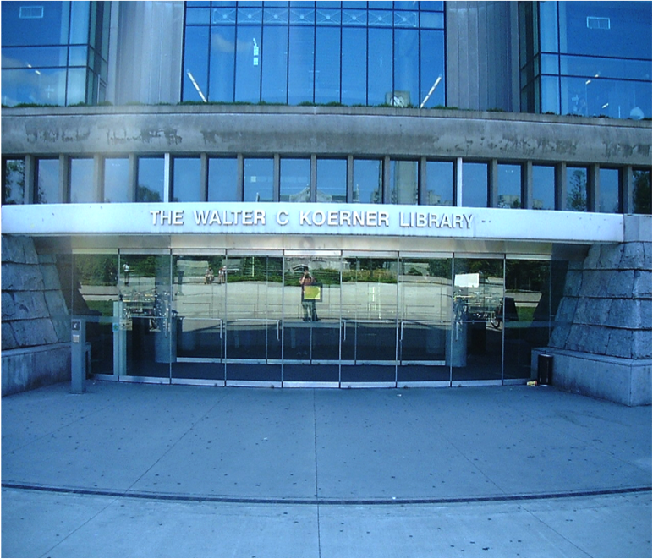
DISABILITY AND DESIGN
Notes:
Welcome, everyone.
[Introductions as appropriate.]
Our focus today is on the relationship between disability and design.
During this session, we’ll consider two perspectives of disability, examine the relationship between disability and design, and think about our role in access and inclusion.
To help get this conversation started, I’d like to play a short video clip for you.

Slide 2
Maggie Little
Maggie Little, BPhil, PhD
Director Senior Research Scholar Professor of Philosophy
Notes:
This video features Dr Maggie Little. She is Director of the Kennedy Institute of Ethics, a Senior Research Scholar and a Professor of Philosophy at Georgetown.
https://www.youtube.com/watch?v=-h0qnGKYjPY

Slide 3
DISABILITY – NOT WHAT YOU THINK IT IS
dis • a • bil • i • ty
dis ə bil i tē
Noun
1. Not what you think it is
Notes:
I’ll be glad to provide you with the link to this video if you’d like to watch the rest, but I wanted to stop the video here at the point where she asks us to think about what disability is. Perhaps she has already caused you to rethink some of your notions about disability.
Would someone like to share you reactions from the video?
What was the question she posed about the fanciful species? What do you think about that?
She uses the phrase “bi-pedal assumption.” What does she mean by that?
What other assumptions are made in the design of things?
What about this idea that people with disabilities may not want to change their bodies?
Do you think Dr. Little’s talk challenges dominant thinking about disability? If so, how?
Does anyone know what it means to say that disability is a “social construct”?
How does Dr. Little make the case for that?
Let’s think a bit more about how we tend to define disability.

Slide 4
Disability definition 1
DISABILITY
an injury, illness, or congenital condition that causes or is likely to cause a loss or difference of physiological or psychological function.
Notes:
This first definition I share with you is as follows:
Disability is an injury, illness, or congenital condition that causes or is likely to cause a loss or difference of physiological or psychological function.
What do you notice about this definition relative to the video we just watched?
This definition makes no mention of the environment in which a person exists. It locates disability fully within the body. So I’d like to suggest, as do disability studies scholars, that we use this definition to describe the bodily condition.

Slide 5
Disability definition 2
DISABILITY
the loss or limitation of opportunities to take part in society on an equal level with others due to social and environmental barriers.
Notes:
What if we were to instead define disability as follows:
Disability: the loss or limitation of opportunities to take part in society on an equal level with others due to social and environmental barriers.

Slide 6
DISABILITY =
BODILY DIFFERENCE + POOR DESIGN = DISABLEMENT
Notes:
So thinking of disability in this way, we might say that when bodily difference encounters poor design this results in disablement, or as the slide states bodily difference plus poor design equals disablement. We could also replace “poor design” with “attitudinal barriers.”
Do you think both are true?
Let’s think for a minute about how this plays out in the way things are designed. If a designer thinks of disability as being an individual problem, do you think it will impact how they approach design?

Slide 7
DISABILITY IS AN INDIVIDUAL PROBLEM: Assumptions
The job of a designer is to design a product for the majority.
Individual differences result in barriers that are not the problem of the designer, but of the individual or a specialist to resolve.
Notes:
In this slide, we see vintage television circa 1960. It is suggested that the assumptions that arise when someone views disability as an individual problem are as follows:
The job of a designer is to design a product for the majority.
Individual differences result in barriers that are not the problem of the designer, but of the individual or a specialist to resolve.
So in the case of the television, since most people are hearing, the television is designed with no capacity to show captions. Deaf people watch it without knowing the content or later, in the ’80s a deaf person could purchase an external device to view captions.

Slide 8
DESIGN IS THE PROBLEM: Assumptions
The job of the designer is to consider all of the potential users and design with that in mind.
Good design equals inclusive design.
Notes:
In this next slide, we see a television with captions. So if a designer recognizes that design can be disabling and locates the problem of disability and exclusion in the design of the product they make different assumptions:
The job of the designer is to consider all of the potential users and design with that in mind.
Good design equals inclusive design.

Slide 9
T.V. Raman, Computer Scientist & Enrico Bianco, Software Engineer Google
Notes:
Let’s take a look at another video that focuses on user-centered design and the role that unconscious bias can play in how we approach design. I’d like to introduce you to two of the people you’ll meet in this video–T.V. Raman, a computer scientist, and Enrico Bianco, a software engineer. Both of them work for Google.
https://www.youtube.com/watch?v=NW5s_-Nl3JE&feature=share
What stood out for you in this video?
What are some examples of design that presents barriers for some people?
What are some creative designs you have seen that provide more usability and inclusion?
Can you think of examples of how designs have changed to be more responsive to human variation?
Are there barriers here on campus that are a result of design that is based on unconscious bias? that does not take into account the diversity of users?

Slide 10
Ostroff quote
Design has the power to make us feel competent or incompetent; it has the power to include or exclude us.
Elaine Ostroff,
Founding director of the Institute for Human Centered Design.
Notes:
As we come to a close, I’d like to share the words of Elaine Ostroff, – founding director of the Institute for Human Centered Design.
“Design has the power to make us feel competent or incompetent;. it has the power to include or exclude us”. Elaine Ostroff
As designers, and we are all designers on some level. When we plan an event, we are designing. When we create a Word document or PowerPoint presentation, we are designing. When we plan course, we are designing. When we create policies, we are designing. When we plan how we deliver our services, we are designing. We each play a role in how society responds to disability through that design.
Thank you for joining me in thinking about the intersection of disability and design today. Feel free to contact me if you’d like more resources on this topic.

Slide 11
Contact Me
Your Name
Email
Etc.
This resource was developed by Southwest ADA Center Regional Affiliate – Arkansas, a program of the University of Arkansas—with a subaward from the Southwest ADA Center funded by NIDDLR.
For more information and resources, go to exploreaccess.org
Notes:
I'd like to thank the Southwest ADA Center Regional Affiliate of Arkansas, a program of the University of Arkansas Partners for Inclusive Communities for developing the content provided in this presentation.

